Slide 1

RV Institute of Technology and Management
Department of Computer/Information Science and Engineering
JP Nagar, Kothanur, Bengaluru - 560076
21CSL55: DBMS LABORATORY WITH MINI PROJECT
Project Title
Presentation
Presented by:
Students Name (USN)
Department
Batch
Under the Guidance of:
Guide Name
Designation Affiliation

Slide 2
Agenda
Introduction
Literature Survey
Proposed System
Motivation
Objective
Hardware and Software Specifications
Methodology
ER Diagram
Schema Diagram
Modules

Slide 3
Introduction
Bullets points
Introduction about project

Slide 4
Literature Survey
Related Papers
Year | Title | Authors | Description

Slide 5
Proposed System
Bullet points
Motivation
Objective
About what is novel with your project

Slide 6
Hardware and Software Requirements
Hardware Requirements
Software Requirements

Slide 7
Methodology
Front end:
Back end :
Modules (With brief explanation)
Admin
Main page
Student
Company

Slide 8
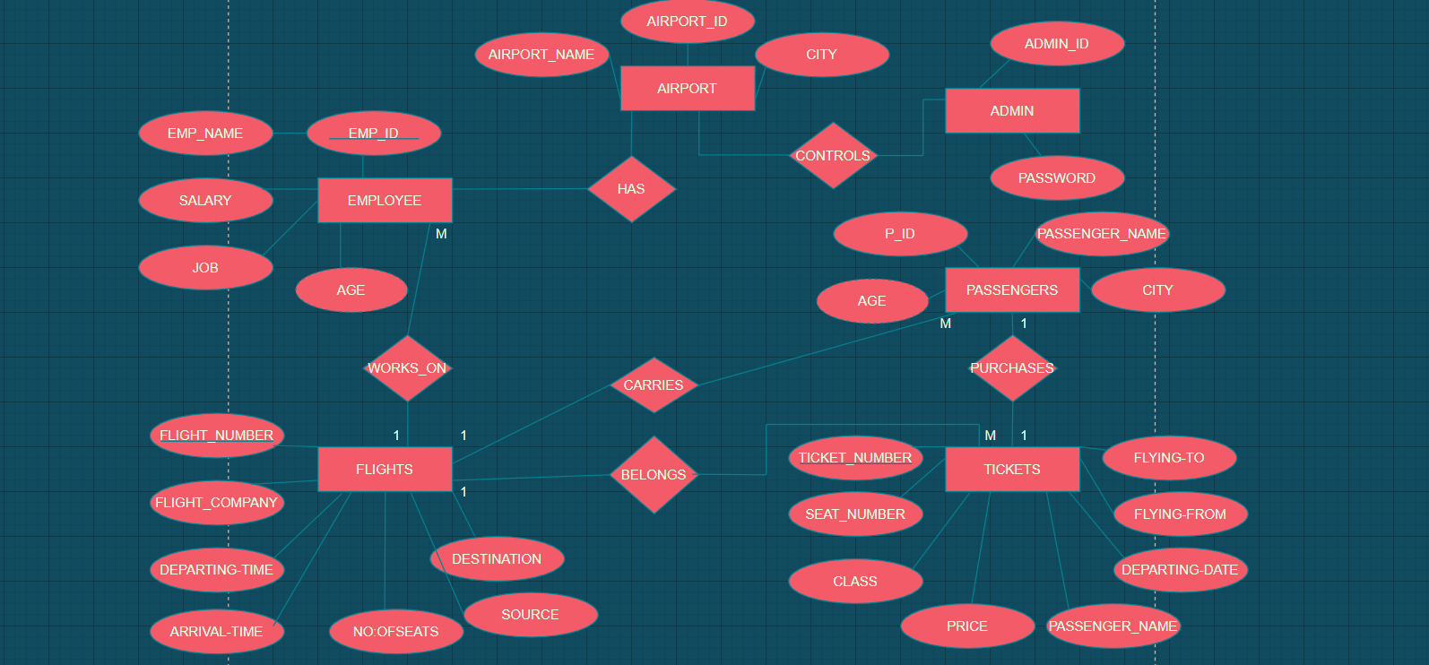
Methodology
ER Diagram (Sample is shown below)

Slide 9
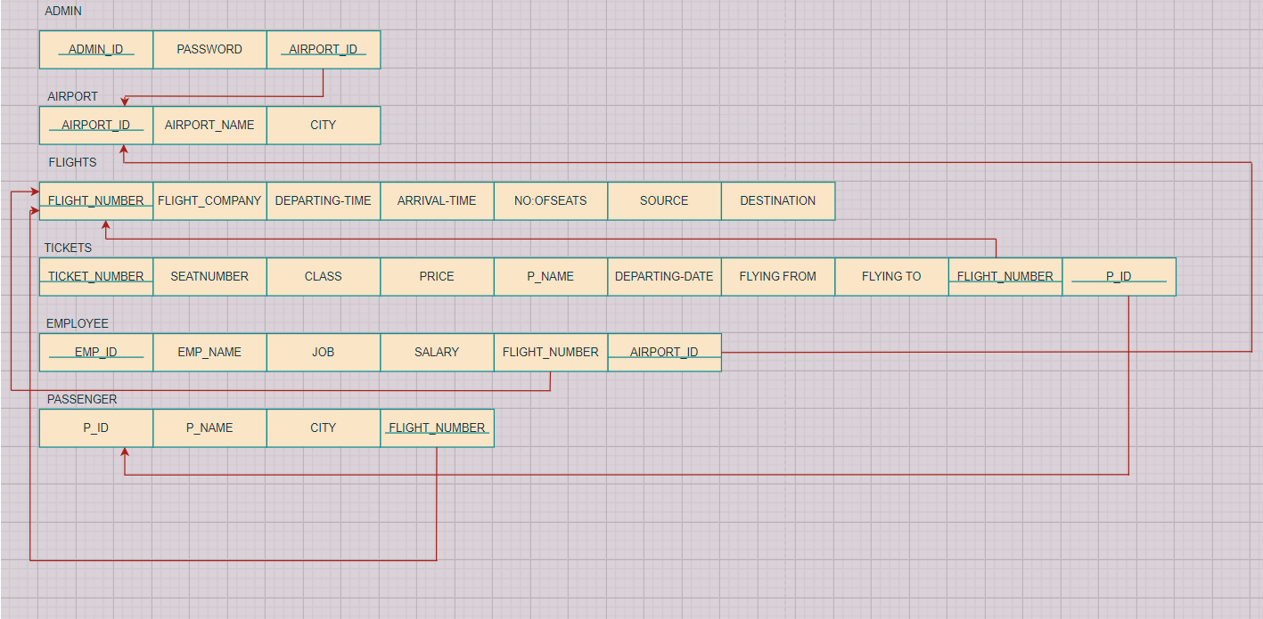
Schema Diagram (Sample is shown below)

Slide 10
REFERENCES

Slide 11
THANK YOU

